Slide 1
Introducción a la Ciencia Ambiental
Semestre 2022-2
Prof. ismael Minjárez

Slide 2
Una pregunta inicial: el hombre como especie animal es carnívoro o vegetariano?
Los grandes simios son omnívoros
El hombre paleolítico consumía carne, frutos y raíces,
Anatómicamente los herbívoros tienen cámaras de fermentación, y nosotros no. Las mandíbulas, las células intestinales y las glándulas salivales están hechas para consumir carne y vegetales.
La agricultura tiene 6,000 años
Junto con ella llegó la obesidad y la diabetes

Slide 3



Slide 4
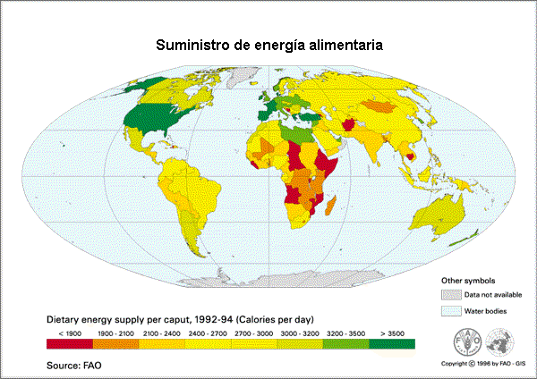
Problema: Consumo mundial de calorías
Las personas necesitan entre 2200 y 2500 calorías diarias
Inequidad entre países y dentro del mismo país

Slide 5
El valor del negocio
En el 2021 el valor del negocio de la carne fue de 897 mil millones de dólares.
Como dato comparativo es el tamaño de la economía de paises como Holanda y Turquía.
Entre el 2016 y el 2020 creció la producción de 317 a 328 millones de toneladas de carne.

Slide 6
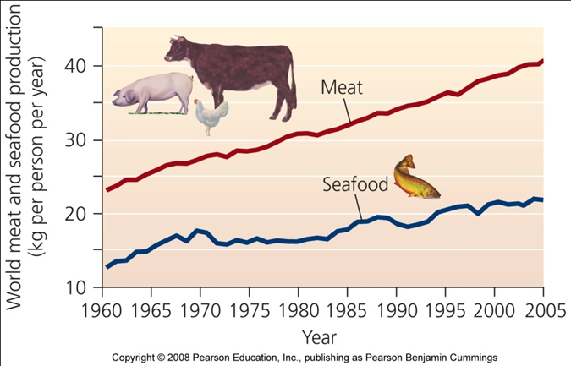
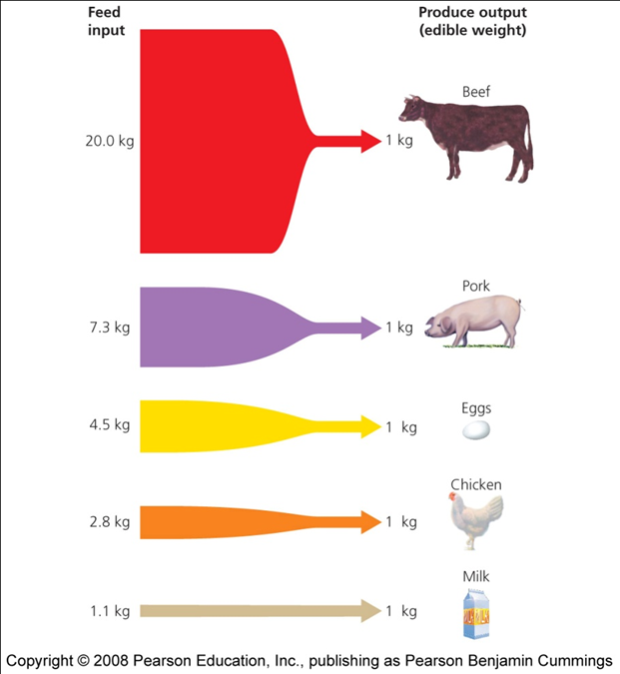
Dos datos
Consumo global de carne y pescado

Slide 7
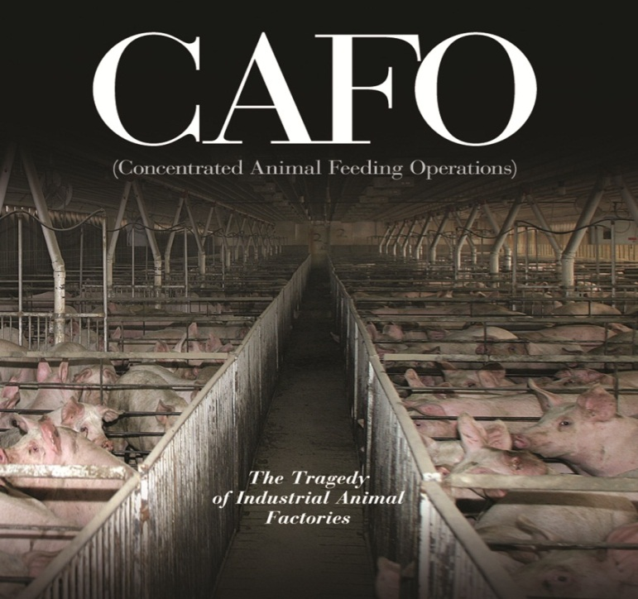
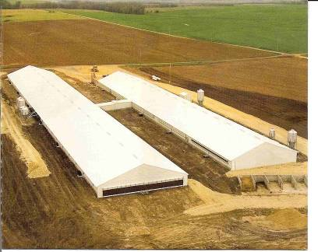
La nueva forma de explotación animal: Granjas masivas
Notes:
Animal agribusiness consists of CAFOs or factory farms. The practice involves confining large numbers of animals in industrialized production facilities. A typical chicken house measures 490 feet long by 45 feet wide and will hold about 30,000 or more chickens (Singer, 23). Pig farms can house 6,000-7,000 pigs and it is not unusual to see cattle feedlots contain 10,000 heads of cattle. 90-95% of all land animals eaten or used to produce milk and eggs in the US originated from CAFOs.

Slide 8
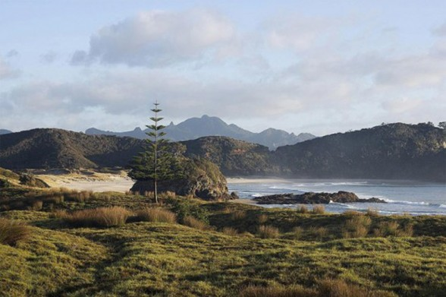
Problemas ambientales
Notes:
Factory farming is a mind set: reduce production costs to absolute minumin and systematically ignore or “externalize” such costs as environmental damage.

Slide 9
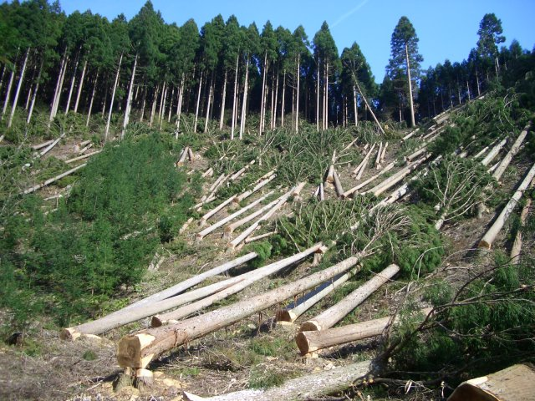
Deforestacion
Notes:
A Smithsonian-sponsored research team found that an area of Amazon-basin rain forest equivalent to seven football fields is being cleared per minute for grazing land (Smithosonian Institute 2002). This contributes to loss of biodiversity when we consider that 40% to 50% of the world’s plant and animal species dwell in rain forests (McKisson & MacRae-Campbell 1990).

Slide 10
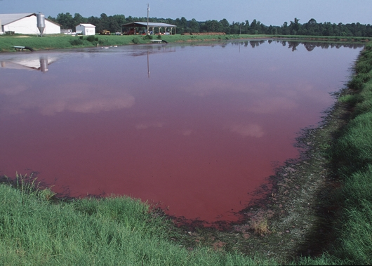
Contaminación de aguas
Notes:
See pages 3- 4 on handout. Waste lagoon can leak or break in cases of bad weather.
Aquifers are threaten by over use, local water supplies and fish populations are under threat by waste seepage. Hormones, antibiotics, bacteria and toxins can contaminate our water supply.

Slide 11
Cambio Climático
De acuerdo a la ONU el negocio de los animals de crianza es responsible del 18 % de los gases invernadero, más que el negocio del transporte.
Consumir un filete de 225 gramos es tan contaminante como una Hummer circulando.
(Time Magazine 2007)
Notes:
Distribute handout: Livestock’s high energy costs

Slide 12

Salud Humana
Resistencia a los antibióticos
83% de l acarne d epollo está infectada por cbacterias o salmonella.
E. coli
Mutaciones de virus (e.g. gripe aviar, H1N1).
Notes:
About 50-70% of all antibiotic use is used on livestock. Nontherapeutic use.
83% stat comes from a Consumer Report study
Factory farming conditions and slaughter procedures are conducive for these bacteria and viral concerns.
Hamburger facility have adopted ammonia injections to sterilize their beef products. http://www.nytimes.com/2009/12/31/us/31meat.html

Slide 13
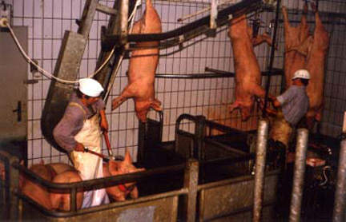
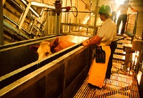
Etica y maltrato animal
Notes:
The average employee lasts less than a year on the job (singer 32).
Immigration labor (distribute handout).
Harm to human psychology. Temple Grandin (Colorado state university) a consultant for the meat industry regarding animal welfare, witnessed deliberate acts of cruelty on a regular basis at 32% of the plants she surveyed during announced visits.
26% of chicken slaughterhouses had abuses so severe they should have failed inspection all together.
25% beef plants had abuses so severe that they automatically failed her audit (like hanging a live animal on the rail). Dismembering live animals and poking cows in the anus with electric prod. (Foer)

Slide 14
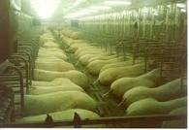
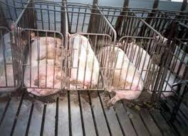
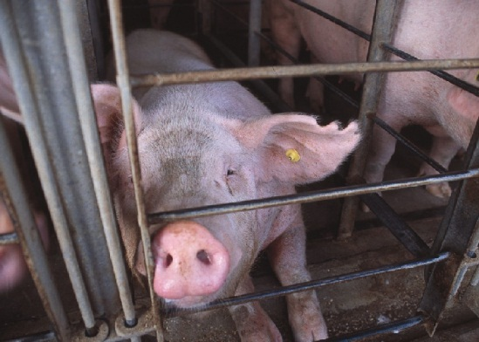
Maltrato animal
Notes:
7 ft by 2 ft^{[2]} metal enclosure
Between 60 and 70 percent of sows are confined in crates during pregnancy in the United States,^{[4]} each pregnancy lasting four months, with an average of 2.5 litters every year.^{[5]} Sows, which can weigh 600 lbs,^{[6]} spend most of their three or four years of adult life in crates.
In the European Union, the crates are being phased out by 2013 after four weeks of pregnancy.^{[10]} They are already banned in Sweden and in the UK, and will be banned in Denmark from 2014.
In the US, they have been banned in Florida since 2004, Arizona since 2006 and California since late 2008.^{[7]} They are also being phased out in Maine and Oregon.^{[11]} Smithfield Foods, the largest pork producer in the US, said in January 2007 that it will phase out gestation crates from its 187 piggeries over the next ten years, because of concerns from its customers, including McDonald's and several supermarket chains. However in 2009 they stated they would no longer be able to phase them out in 10 years due to low recent sales.^{[7]}
Breeding sows are confined in gestation crates throughout their nearly four-month pregnancies, before being herded into similarly confining farrowing crates to give birth. The piglets are taken away after just two to three weeks and the process is begun again; the sow is re-impregnated and forced into a gestation crate for yet another pregnancy. This cycle is repeated until the sow is considered "reproductively spent," often after just two or three years in production.

Slide 15
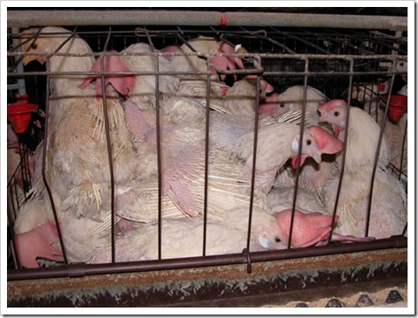
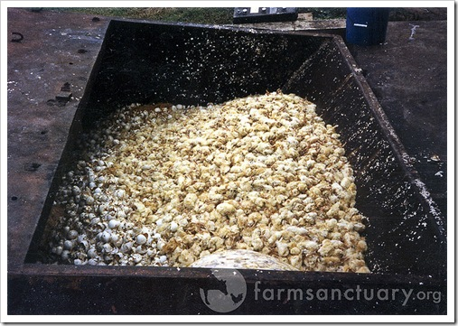
Alimentos reciclados
Notes:
Egg-layers: debeaked, piece of paper, calcium depleted, no sunlight, no freshair. 2 years old. Male chicks are killed at a rates of 250 million per year, gassed, electrocuted, fertizlier, suffocate in trash.

Slide 16
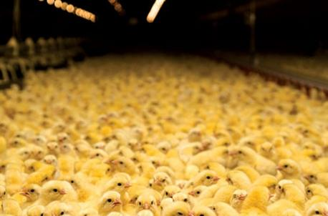
Incubadoras
Modificado genéticamente para crecer rápido
Producción masiva de huevo
Notes:
Cage-free chicken: A typical chicken house measures 490 feet long by 45 feet wide and will hold about 30,000 or more chickens (Singer, 23). That’s about eight-tenths of a square foot per bird (industry’s standard) Foer, 129
Respirtory illness, crushed to death. Nothing resembling their natural behavior.
6 weeks of age. Increase of 400% growth since domestication of chickens. Grows so fast that between 1-4 % will die from sudden death syndrome (writhing in convusions). 3 out of 4 will have a walking imparment.
30% of all live birds arriving at the slaugher house have broken bones as a result of their genetics and rough treatment. No laws protects birds once they arrive at the slaughterhouse. Animal welfare act does not protect them.

Slide 17
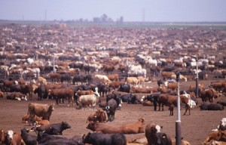
Ganado bovino
Notes:
Cows are fed corn makes their liver sick, use of anitibiotic to keep them alive as long as possible which is about 2 years of age, then they meet market weight. More than 90% of US cattle on feedlots are implanted with hormones (Baur, 121) (athelets debate).

Slide 18
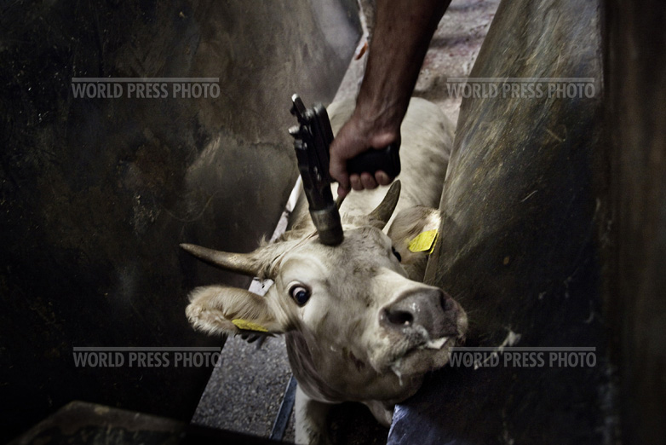
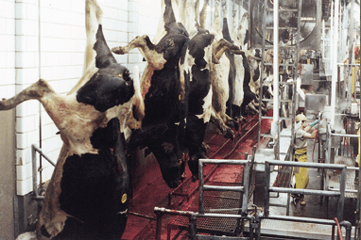
Sacrificio de vacas
Notes:
When Temple Grandin conducted an industry wide audit in 1996 her studies revealed that the vast majority of cattle slaughterhouses were unable to render cattle unconscious with a single blow.
e. Coli infections due to a fast conveyer line.
They die piece by piece NY Time article (distribute)

Slide 19
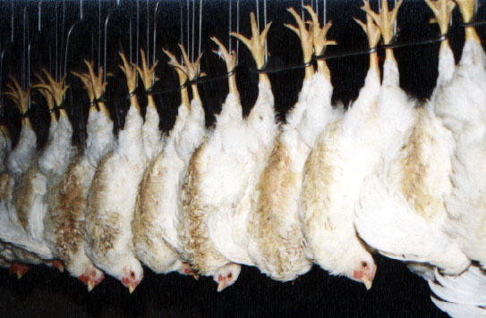
Sacrificio de pollos
Notes:
This is the industry’s figure. National Chicken Council.
Birds are going alive and conscious into the scalding tank.
The inspector at this rate looks at about 25,000 birds a day for more than a dozen different diseases and suspect abnormalities. (foer 134).

Slide 20
Recapitulación del consumo de carne
Daño ambiental
  Sustentable?
Salud Humana
  Consecuencias a largo plazo?
Animales
  Maltrato necesario?

Slide 21
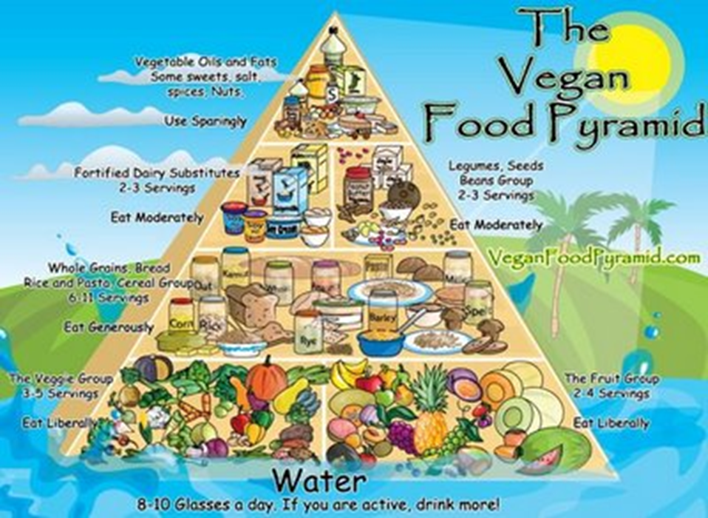
Veganismo

Slide 22
Problemas de la producción de alimentos vegetales
Ambientales
  Deforestación para ampliar terrenos para agricultura
  Contaminación de suelos por uso de agroquímicos
  Monocultivos y pérdida de biodiversidad
  Organismos genéticamente modificados
Problemas de salud pública
  Cáncer por agroquímicos
  Desnutrición por déficit de proteínas
Consumo de recursos
  Problemas de escasez de agua.

Slide 23


Cual es tu opinión?
Que se debe hacer?
VS

Slide 24
La producción verde
Producción y manejo de terrenos agrícolas orgánica sin agroquímicos
Manejo integral de pastizales
Respeto a la biodiversidad y no Organismos Genéticamente Modificados
Optimización del uso del agua mediante tecnología
Respeto a las costumbres ancestrales

Slide 25
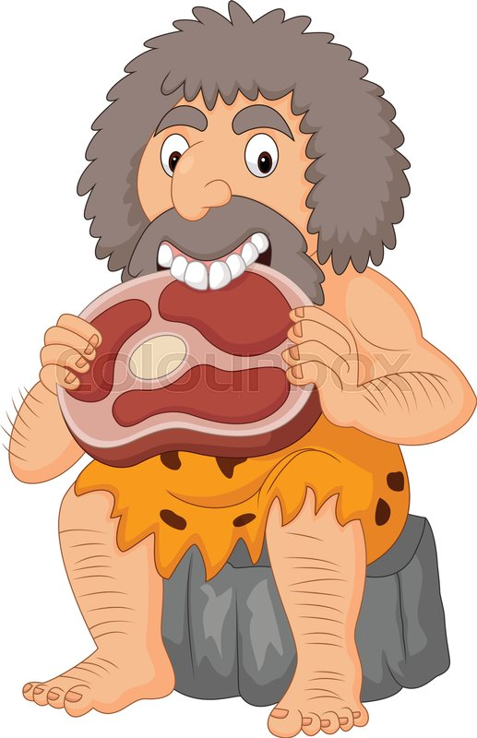
Preguntas?

